Slide 1
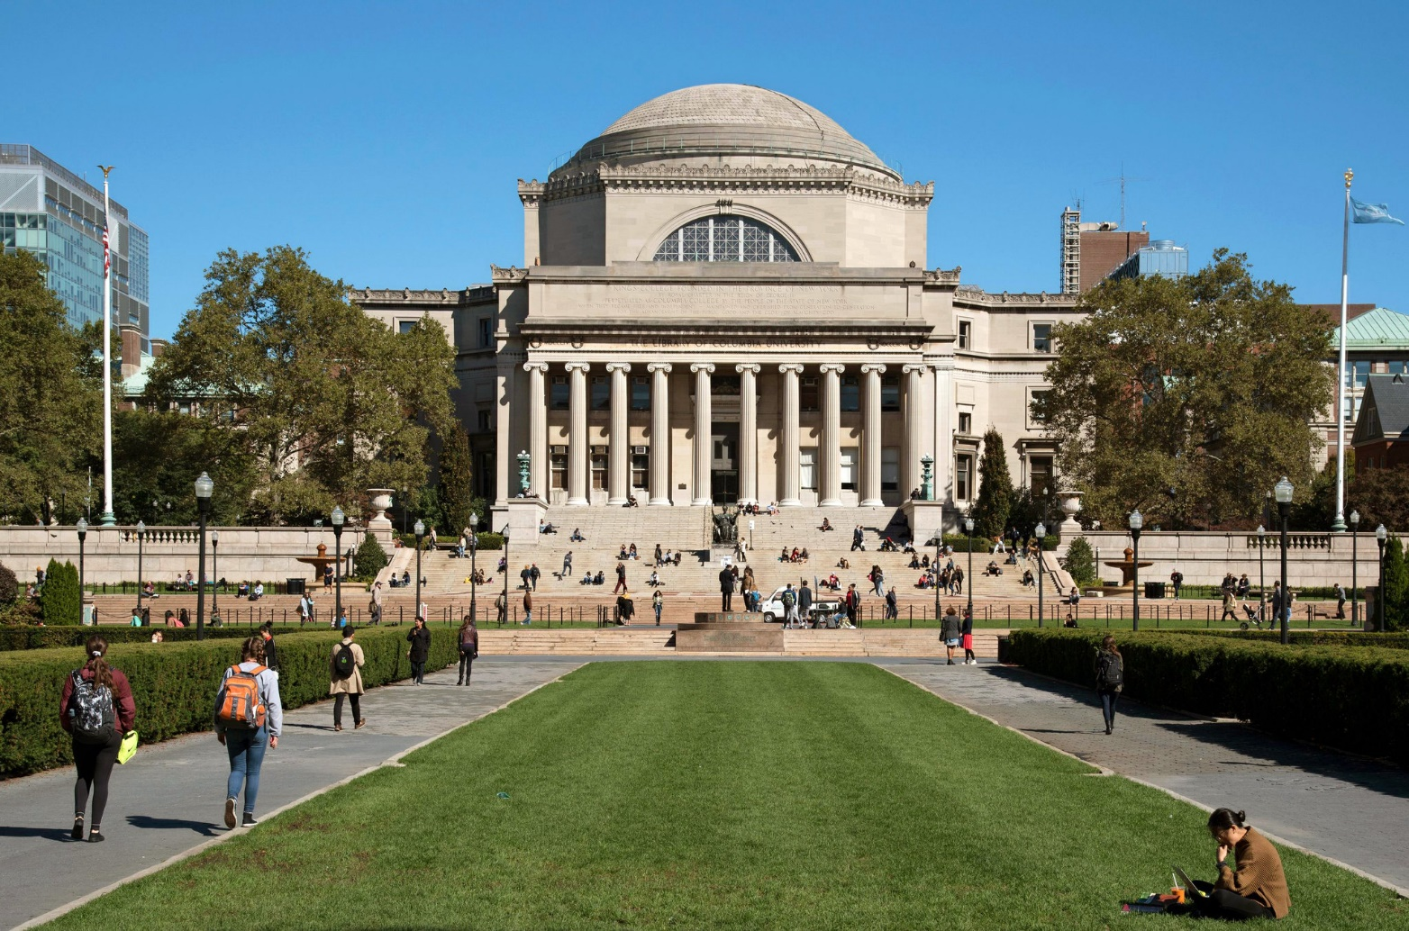
Columbia University in the city of New York

Slide 2
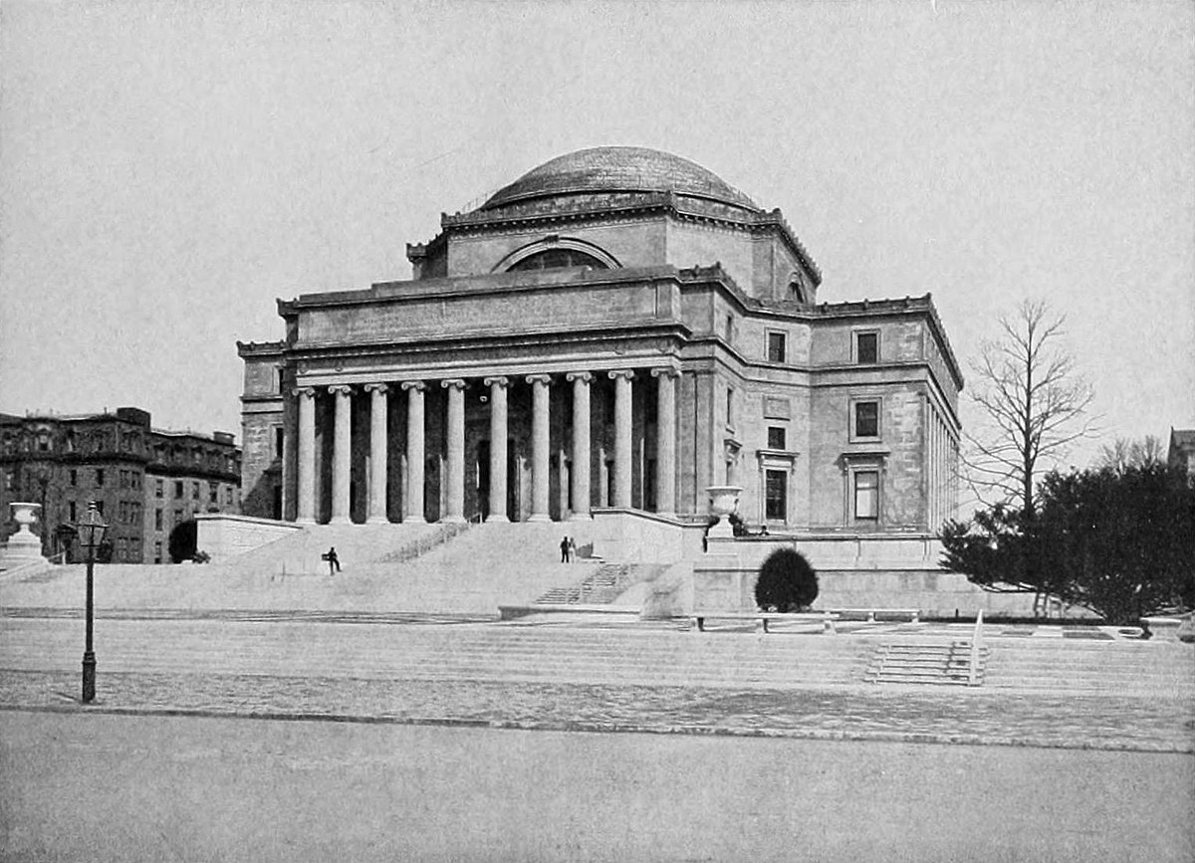
History of the university
Columbia University (also known as Columbia, and officially as Columbia University in the City of New York) - private Ivy League research university in New York City. Established in 1754 as King's College on the grounds of Trinity Church in Manhattan, Columbia is the oldest institution of higher education in New York and the fifth-oldest institution of higher learning in the United States. Columbia was established by royal charter under George II of Great Britain. It was renamed Columbia College in 1784 following the American Revolution, and in 1787 was placed under a private board of trustees.

Slide 3
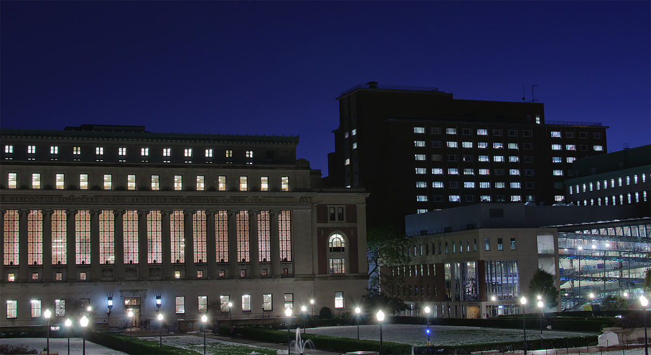
Students
In 2020, Columbia University's student population was 31,455 (8,842 students in undergraduate programs and 22,613 in postgraduate programs). On-campus housing is guaranteed for all four years as an undergraduate. First-year students usually live in one of the large residence halls situated around South Lawn: Carman Hall, Furnald Hall, Hartley Hall, John Jay Hall, or Wallach Hall (originally Livingston Hall).
Carman Hall

Slide 4
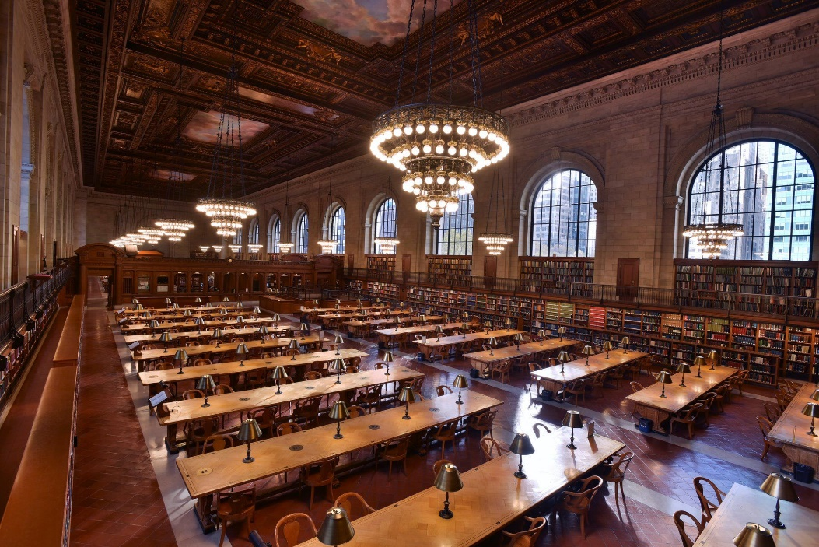
Undergraduate admissions and financial aid
Additionally, 50% of all undergraduates received grants from Columbia. The average grant size awarded to these students is $46,516. In 2015–2016, annual undergraduate tuition at Columbia was $50,526 with a total cost of attendance of $65,860 (including room and board). Annual gifts, fund-raising, and an increase in spending from the university's endowment have allowed Columbia to extend generous financial aid packages to qualifying students. On April 11, 2007, Columbia University announced a $400 million donation from media billionaire alumnus John Kluge to be used exclusively for undergraduate financial aid.
university library

Slide 5
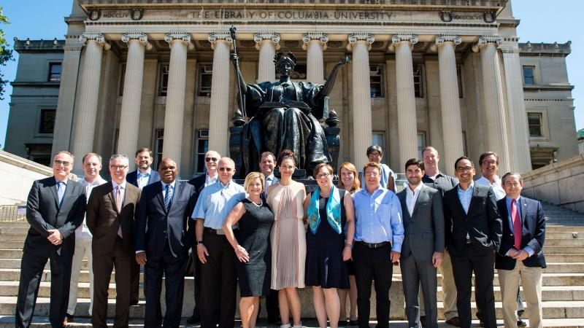
Teaching staff
As of 2021, Columbia employs 4,381 teachers, including 70 members of the National Academy of Sciences 178 members of the American Academy of Arts and Sciences and 65 members of the National Academy of Medicine. In total, the Columbia faculty has included 52 Nobel laureates, 12 National Medal of Science and 32 National Academy of Engineering.

Slide 6
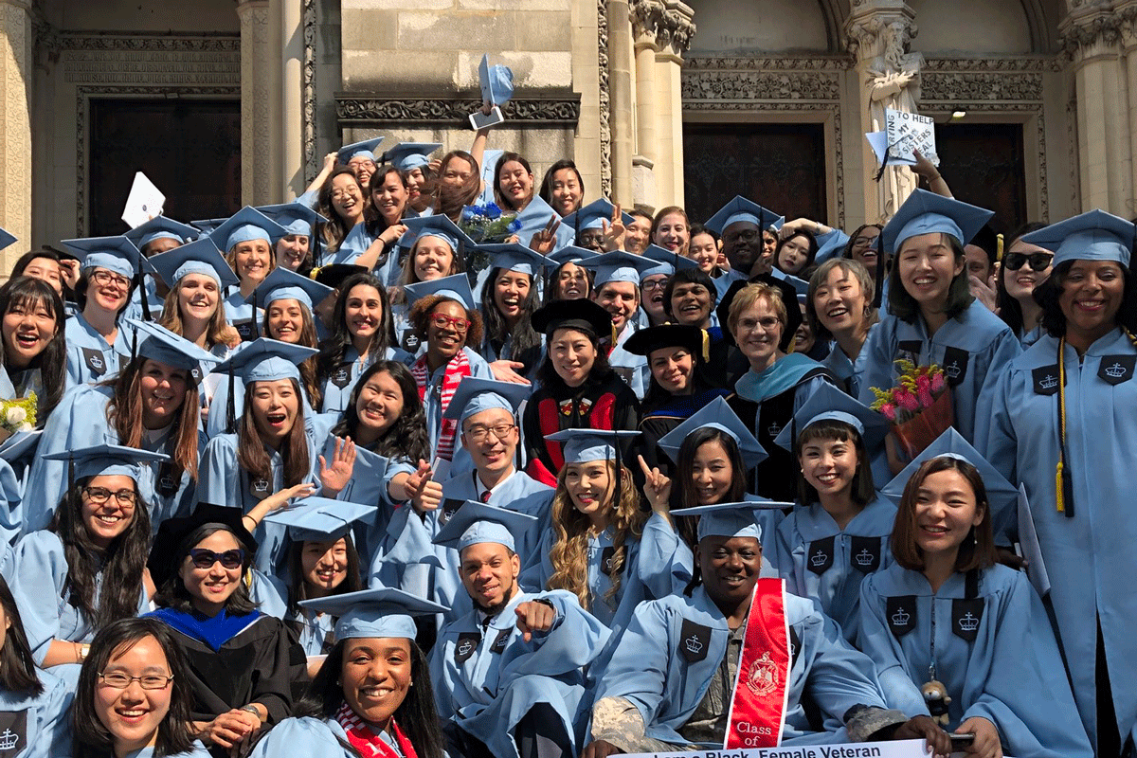
Alumni
The university has graduated many notable alumni, including five Founding Fathers of the United States, an author of the United States Constitution and a member Committee of Five. Three United States presidents have attended Columbia, as well as ten Justices of the Supreme Court of the United States, including three Chief Justices. As of 2011, 125 Pulitzer Prize winners and 39 Oscar winners have attended Columbia. As of 2006, there were 101 National Academy members who were alumni. Other political figures educated at Columbia include former U.S. President Barack Obama.

Slide 7
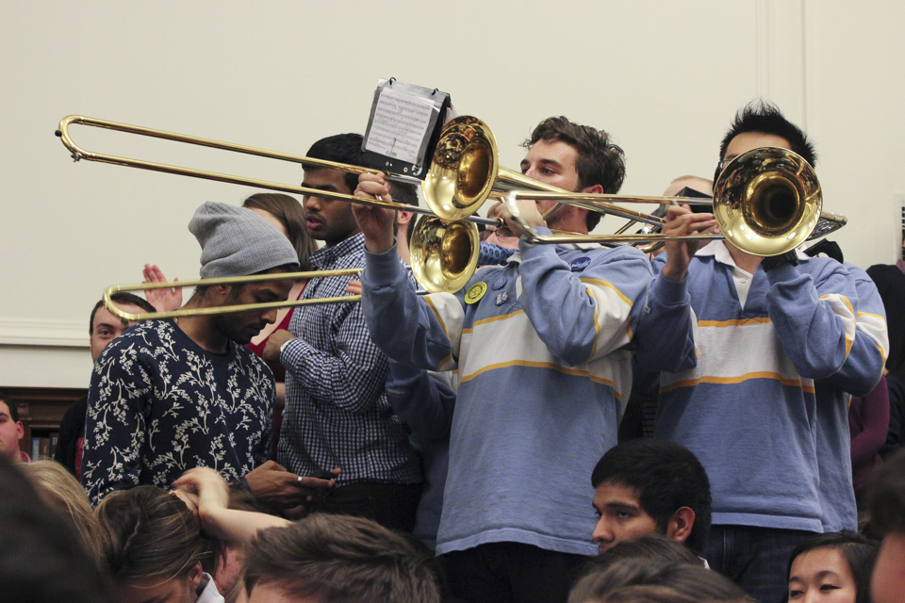
Traditions
Orgo Night
In one of the school's longest-lasting traditions, begun in 1975, at midnight before the Organic Chemistry exam—often the first day of final exams—the Columbia University Marching Band invaded and briefly occupied the main undergraduate reading room in Butler Library to distract and entertain studying students with some forty-five minutes of raucous jokes and music, beginning and ending with the singing of the school's fight song, "Roar, Lion, Roar". After the main show before a crowd that routinely began filling the room well before the announced midnight start time, the Band led a procession to several campus locations, including the residential quadrangle of Barnard College for more music and temporary relief from the stress of last-minute studying.

Slide 8
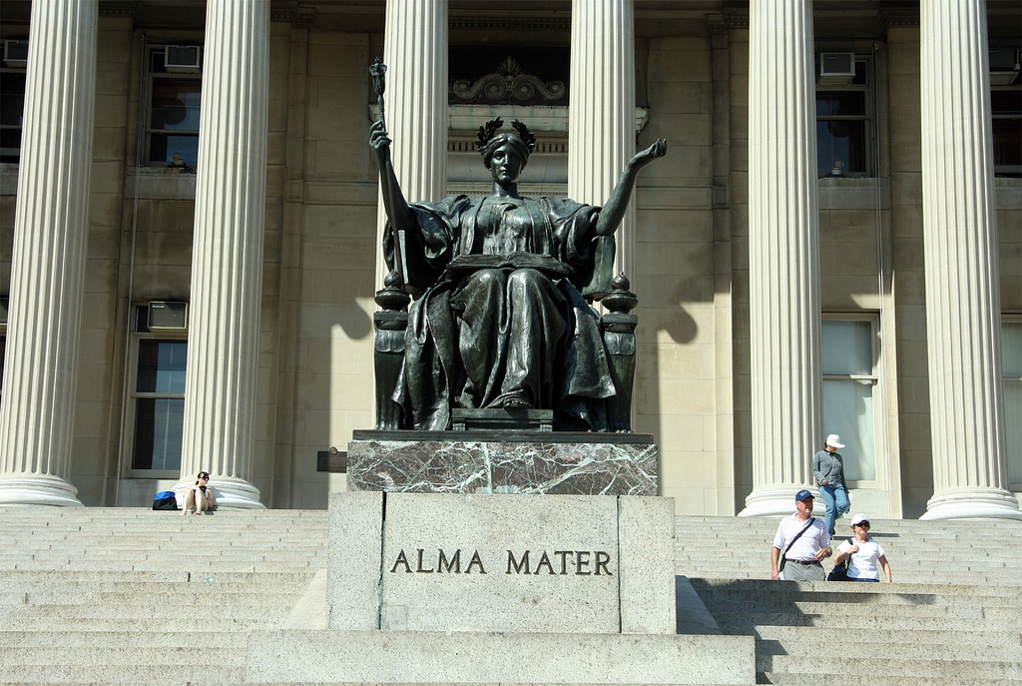
The owl and alma mater
Alma Mater is literally the mother soul of the college/university. An owl is hidden in the folds of Alma Mater's robes. Legend holds that the first member of the incoming class to find the owl hidden on the statue of Alma Mater in Low Plaza will become the class valedictorian.

